Slide 1
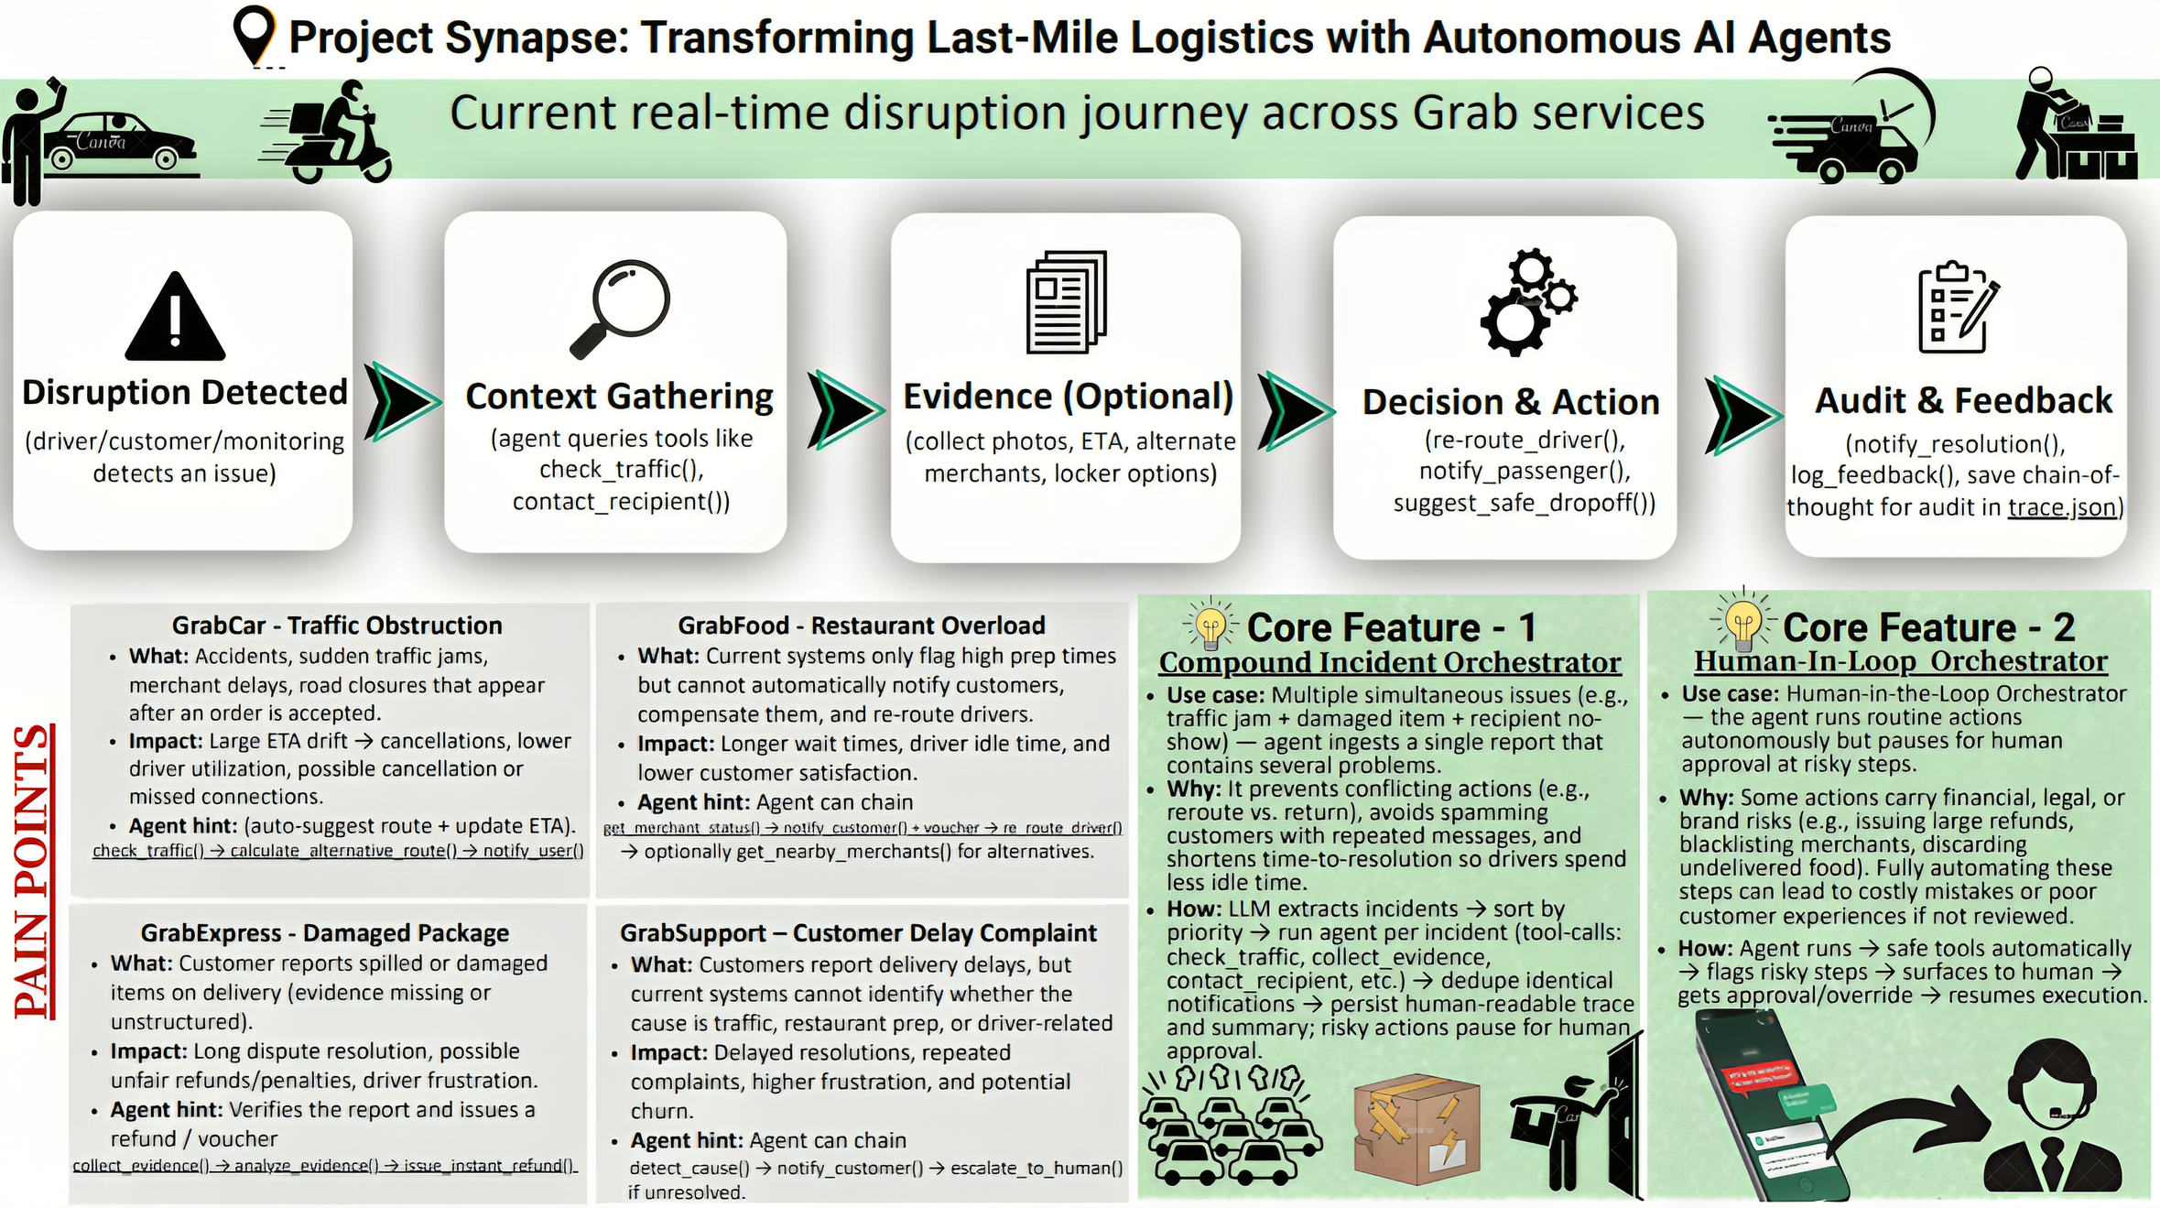

Slide 2
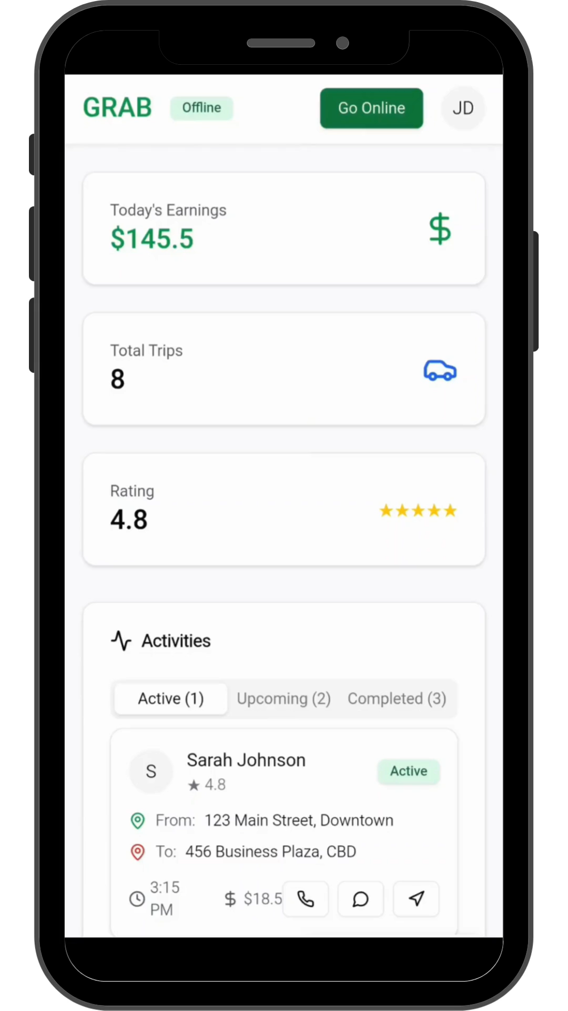
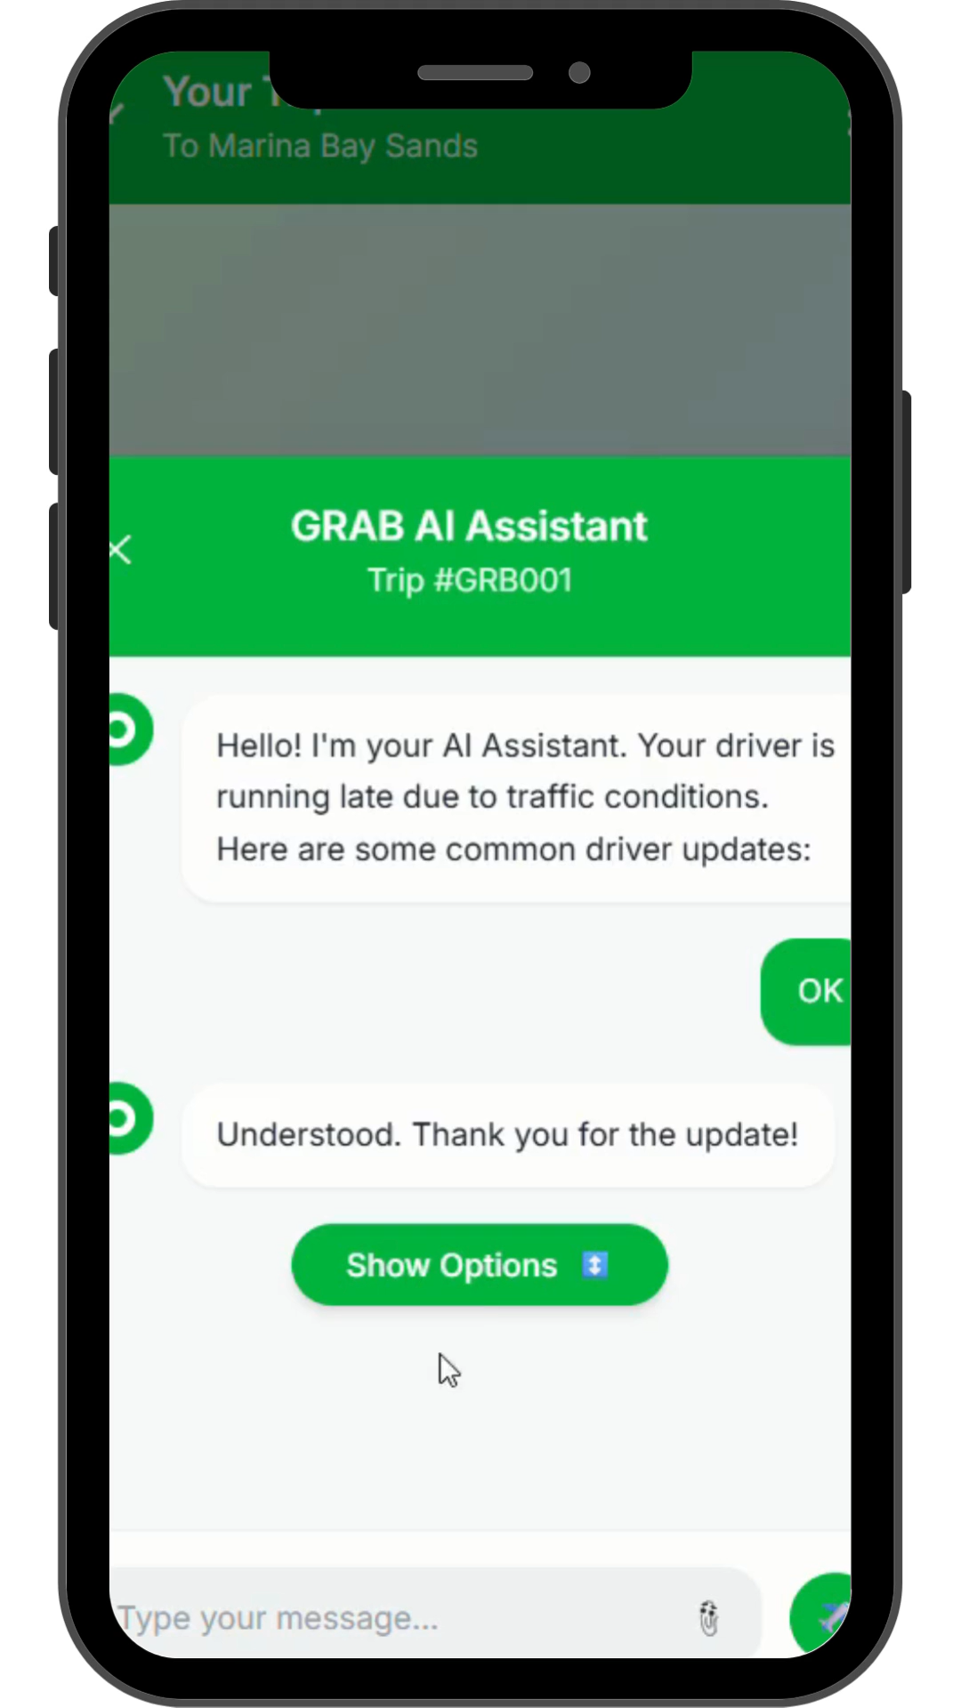
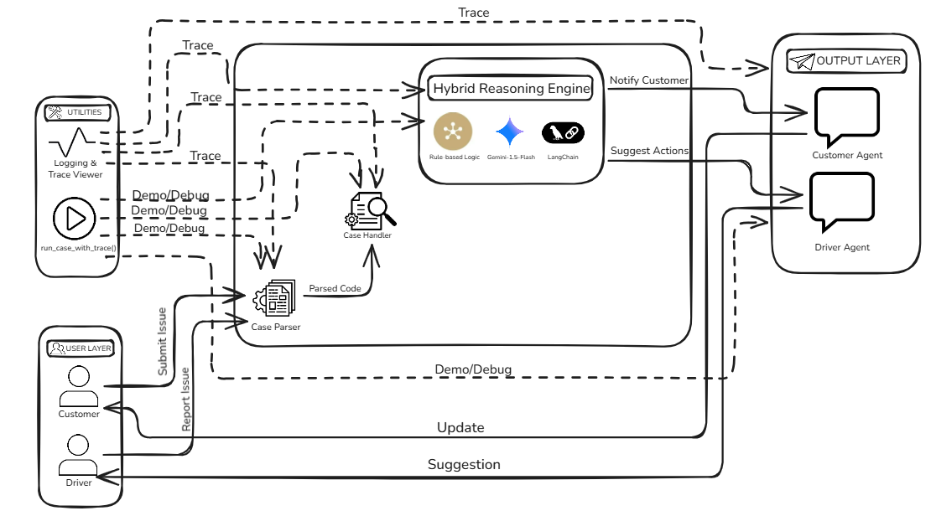

GrabNavi – Real-time assistant for smoother rides & deliveries
Click To Play Stimulated Mock Demo
Use Case Diagram
Driver Reports Delay due to Traffic
AI Informs Customer of Delay & Assists
Driver reports being stuck in traffic while en route to the customer.
AI Agent processes the report → calculates alternative route.
AI notifies the customer with delay details and expected arrival time.
Customer receives notification: driver is delayed due to traffic.
Customer acknowledges but later reports: “I cannot find the driver.”
AI Agent responds promptly, assists with locating driver, and ensures smooth resolution.
GitHub Link: GrabNavi GitHub
Google Colab Link: GrabNavi Colab Link

